Slide 1
Walkout Monitor
By -Kijit Desai (kd227)
-Nandakishore Yemparala(ny44)

Slide 2
Overview
Our application lets the users monitor their current and average speed while running.
It allows the users to monitor their past workouts as well.
Another feature to this app is that the user can calculate lifts, i.e. the number of time the user lifts the phone up and down.

Slide 3
Project workflow
Frameworks
Individual fragments
Data Storage
UI
Getting it all together

Slide 4
Frameworks
CoreLocation framework
Mapkit framework
CoreData framework
UIkit framework (accelerometer Delegate)

Slide 5
Individual fragments(sensors)
Running speed ( GPS)
Lifts(Accelerometer)

Slide 6
User Interface

Slide 7
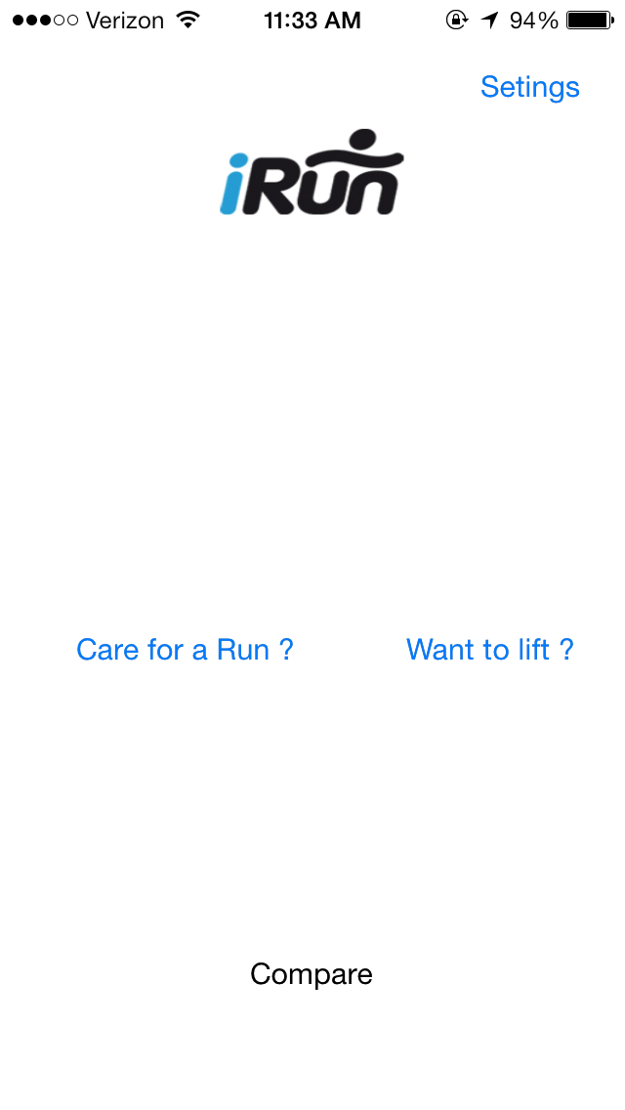
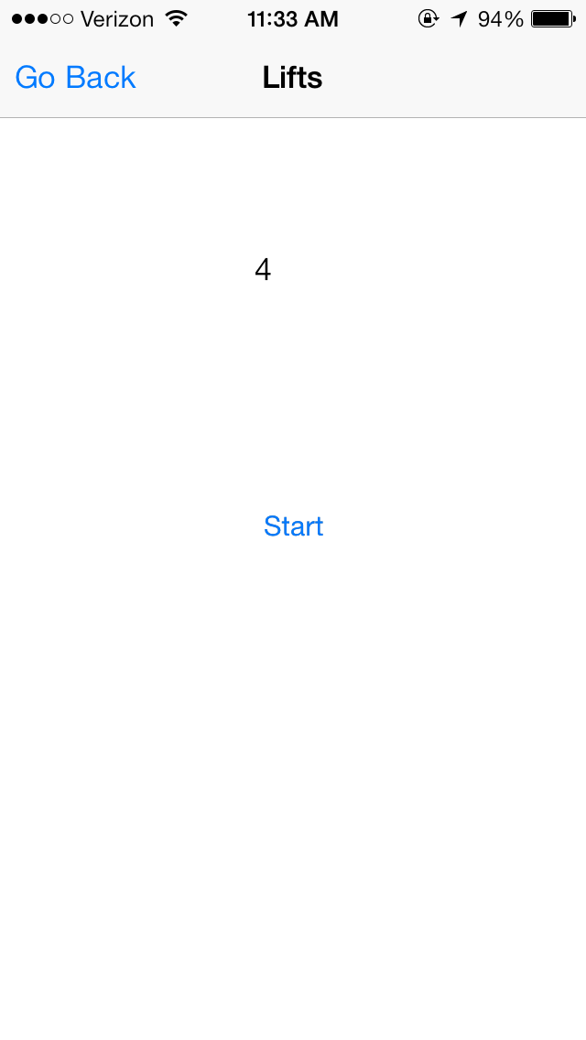
User Interface(2)

Slide 8
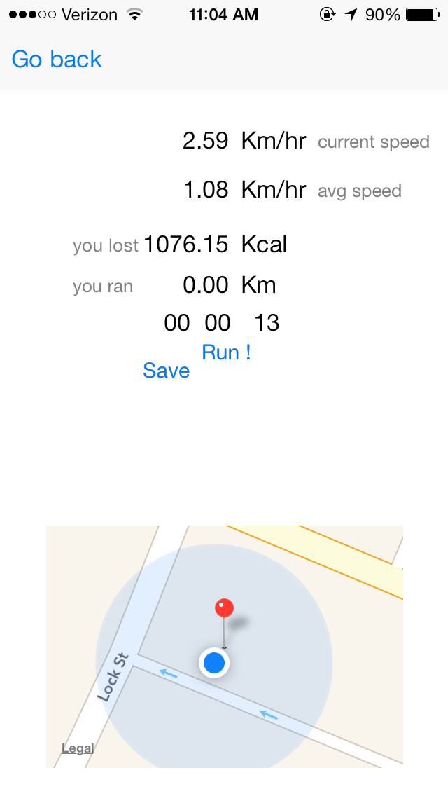
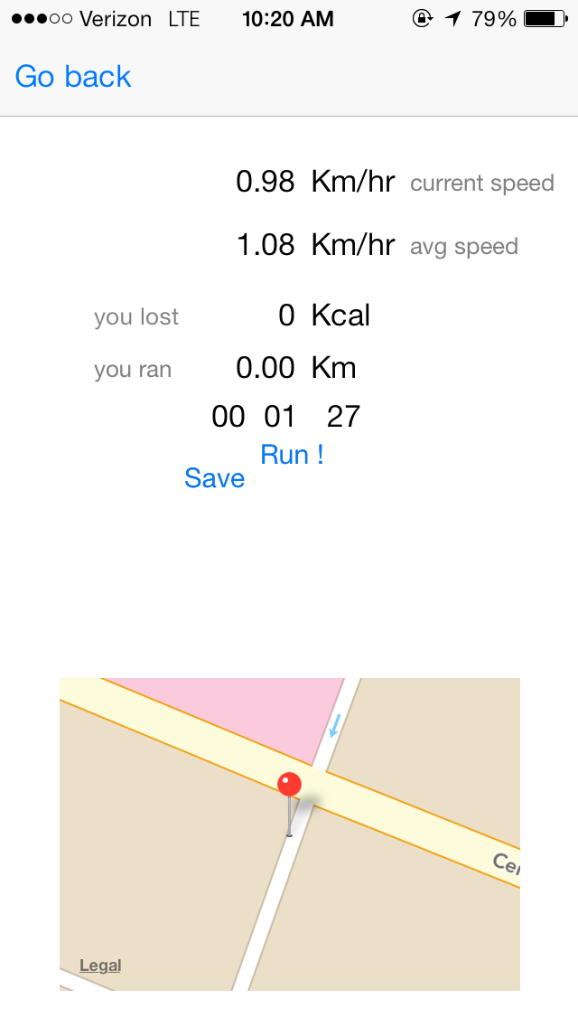
User Interface(3)

Slide 9
Core Data
Record Schema

Slide 10
Getting it all together
We started this with adding the UI first
Then we moved to individually add the running and lifting views

Slide 11
Comparing with other apps
The functionalities implemented by us are available in some of the latest paid apps.
But not all apps have all the features that we do.
The apps available with running speed as well as lifts do not provide a map view for the user location
Our app has a lot more scope to increase functionalities

Slide 12
Future Scope
Show the path that user as followed while running
Give tips on running exercises
Alarm for dialing running routine

